Slide 1
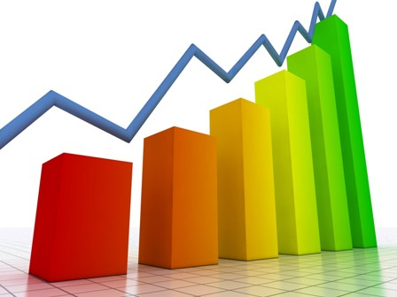
My Data Interactive Notebook
Name
Class
Teacher
Semester 2
Term 3
1

Slide 2

Interactive Notebooks!
Cover Page
Contents Page
Glossary
24/7/30
EQ
Questions
Notes
Summaries
Work page
Presentation!!!
Your book, your responsibility!

Slide 3
From last class:
Complete the following sentences:
The ______ of all values, divided by the __________of values is called the mean.
The median can be calculated by finding the ___________ values of the numbers placed in ascending or descending __________.
a) Find the mean of the following set of data: 1,2,3,4,4,80
b) Find the median of the following data: 1,2,3,4,1,2,4,3
*How does the last value affect the mean in a) ?

Slide 4
The Mean, Median and Mode Toads
https://www.youtube.com/watch?v=5C9LBF3b65s

Slide 5
24
7
30
Measures of Location
Date
EQ – What are some examples of descriptive statistics and what do we use them for? (Continued from last class)
How do we find the measures of location?
Last class we learned about mean and median, two of the three main measures of location. The last measure of location is:
Mode - This is the most frequently occurring value in the distribution
Value that Occurs Most Often
There May Not be a Mode
There May be Several Modes
0 1 2 3 4 5 6 7 8 9 10 11 12 13 14
Mode = 9
Summary:

Slide 6
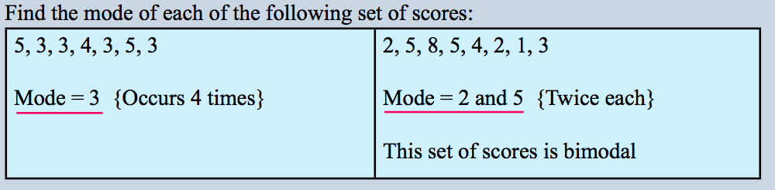
24
7
30
Measures of Location
Date
EQ – What are some examples of descriptive statistics and what do we use them for? (Continued from last class)
How do we find the measures of location?
Example:

Slide 7
24
7
30
Measures of Location
Date
EQ – What are some examples of descriptive statistics and what do we use them for? (Continued from last class)
In addition to measures of location, it is also helpful to know how spread out the data are. For that, we have us a measure of spread called Range
What is Range?
Range is the distance between the largest and smallest values.
How is Range calculated?
Range = Maximum value – Minimum Value.
Example: 2,4,5,5,7,8,9,11,15,17,19,21
Range = Max - Min
= 21 – 2
= 19

Slide 8
Task - Guided
Work out the Range of each of the following sets of data showing clearly all the steps in your working.
3,9,12,15,16,18,21
152, 167, 159, 162, 140, 157, 163, 160, 155, 141, 158
Range = max – min
= 21 – 3
= 18
Range = max – min
= 167 – 140
= 27

Slide 9
Task - Guided
Work out the Range of each of the following sets of data showing clearly all the steps in your working.
3. 1.4, 2.7, 0.2, 3.5, 4.1, 2.3, 1.9, 2.2, 1.6, 2.0, 1.6, 2.6, 2.2 ,1.8, 2.9, 3.0
4. 62,51,48,55,56,43,59,48,57,60,47,55
Range = max – min
= 4.1 – 0.2
= 3.9
Range = max – min
= 62 – 43
= 19

Slide 10
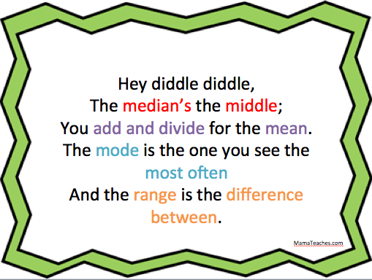
How can you remember all this?

Slide 11
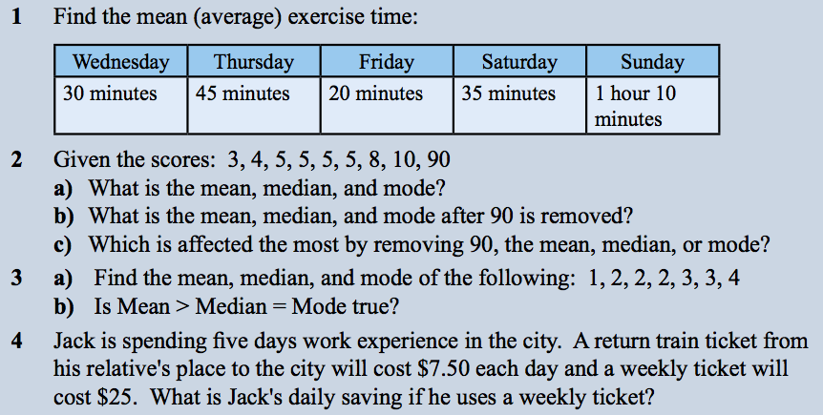
Finish the last two columns from Mean, median, Mode and Range Wksht from last class
Answer the EQ in your summary
Once done that,

Slide 12
Notes Review
24, 7 ,30
Date
Title
Essential question
Notes complete
Notes complete with colour and diagrams
Questions completed
Contents page filed in
Formula page filled in

